Slide 1
Algorithms
General Introduction
Notes:
An algorithm is just a set of steps you need to follow in order to achieve a result. Humans have used them for thousands of years and nature has evolved them because they work. It’s an abstract and loose concept and it’s hard to say what is and is not an algorithm sometimes.
But in science and technology certain types of algorithms seem to appear again and again. It’s an enormous field, even bigger than learning programming languages.
This is a general introduction to algorithms, as they relate to IT.
You already know about algorithms with the coding experience and the life experiences you have
What’s missing is maybe the theory behind the experience
We’ll put some structure on that knowledge, add some vocabulary to your CV and your conversational skills with an interviewer or a colleague

Slide 2

A Bootcamper’s dream…
Interviewer:
How do you sort this array of numbers?
Let myArray = [34, 939, 30, -3, 32, -920, 344, 344, 12…];
Bootcamper:
Easy!
Call myArray.sort()
Time for MY questions now:
What’s my starting salary?
How many days holiday?
Parking space?
Notes:
How would the audience answer the question? It could be right at any given level of detail.
It’s not just interviewees. I’ve come across new joiners who have given this answer.
Analogy:
If you ask someone, what makes a car go? One might say “the pedal”, another might explain how the engine drives the wheel. Who would you rather employ to build the next car?
Both might think they have given the right answer. Because we don’t know what we don’t know.

Slide 3

…dream turns into nightmare…
Interviewer:
Not so fast!
What if my array contains a million zillion elements?
…and I only want the first 50?
What if the possible element values are a fixed set? Like days of the week?
…
Bootcamper:
Pahh! What if you shoved your job up your (*”&(“!
*This is the second reason the interviewee didn’t get the job
Notes:
We need to understand that even though libraries are created to be easy to use, that doesn’t mean there’s no need to understand what is happening under the hood.
Why? Because we are engineers, We are not users.
We need to understand how the engine works. What makes it perform well or badly. What are the conditions in which it’s designed to work.

Slide 4

…a more constructive answer might be…
Bootcamper:
I’d investigate how Array.sort() works internally and analyse whether it is suitable for my purposes
I’d implement code that is optimal for my requirement
Either way: You have to understand something about sorting algorithms, and algorithms in general
Notes:
These workshops aim to convert you from being programmers who USE packages and libraries into developers with a more holistic understanding of how they work and how they behave.
With a deeper understanding of how algorithms in libraries work, you will be able to:
Solve problems independently
Make design choices rather than following another analyst’s design
Have more responsibility and control in the team (the other stack)
Your CV will contain phrases like: “good understanding of computer science concepts such as sorting algorithms and data structures”
Your interview experience will go something like:
“What sorting algorithms do you know?”,
“Well there’s insertions sort….there’s merge sort…”
“Explain how insertion sort works”
“Yes of course…..”
“Would you like me to explain….too?”
You won’t be on the defensive
But why do we need to know them once we got the job – there are standard libraries
Standard libraries are getting better and better, but to be easy to use they have to be simple to call and general. So, they have to make compromises.
General solutions in general can’t be good at everything, and there will be edge cases where the general solution could be replaced by a simpler solution that is:
efficient
Has no external dependencies
and easy to maintain.
You will very rarely have to implement many of these algorithms, but that doesn’t mean it’s not useful to understand them.
Example:
If you had to sort a list of a billion Booleans, you wouldn’t just create an array of them and pass them into sort.
Just count the ones and count the zeros.

Slide 5
…and it’s not just sorting algorithms
Sort
Encrypt
Compress
Simple Coding Patterns are algorithms
Solve
Simulate
Optimise
Search
Control
Notes:
Search
Google made billions on one web page with one input text field and one button. I don’t think they needed too many html/css/javascript developers back then.
Solve
Some equations are hard for mathematicians to solve. Programs can do it numerically easily
Simulate
Architecture
Weather forecasting
Formula 1 racing
Optimise
Sports and exercise vs performance
Control
Home automation systems

Slide 6
What is an algorithm anyway?
The word comes from a 9th Century Persian mathematician called “Abdullah Muhammad bin Musa al-Khwarithmi”
The idea is a LOT OLDER than computers and programming
Algorithms can be learned INDEPENDENTLY of programming
In fact, algorithms are what DRIVES programming
An algorithm is basically a set of instructions designed to achieve a desired result
In any language you like.
Notes:
They are a standalone concept.
Learning algorithms are more tangible than keywords and commands.
You might find that you find it easier to think about algorithms than programming. Learning one helps the other, it doesn’t need to be one after the other.
Half of my job switches I didn’t know the required programming language. (you need to know at least ONE already though!)

Slide 7
Use any language you like
Natural/human language
While job hunting and waiting for opportunities, spend your time building knowledge that can improve your CV and your interview performance.
Pseudocode
for (I = 1 to LENGTH-1)
{
for (J = 0 to LENGTH-2)
{
if (A[I] > A[J])
{
doSwap(I,J);
}
}
}
No
Sleep
Alarm ringing?
Press snooze
Flowchart
Yes
Notes:
Pseudocode: You can just make up your own syntax
On the flow chart, the rounded rectangle is a terminator (start/stop), rectangle is a process (something happens), diamond is a decision (if/then/else), circle is a connector. The arrows show the path of the “Program Counter”
Do you want a workshop on “Communicating through Pictures”?
Have you done flow charts?
State diagrams?
ERD?
Object/Class?

Slide 8
But use language precisely
For these workshops, this is not an algorithm
This is declarative
select CITY, count(*) from
CUSTOMERS
where STATUS = “NEW”
group by CITY
having count(*) > 50
order by CITY
But under the hood, the computer will be running an algorithm. One of them will be a sorting algorithm.
Algorithms are typically written in an imperative style:
“Doing” words – verbs
Objects involved should be reasonably precisely understood, e.g
Positive integers
Array
Month
Observables and State
Things that happen
Things that are
Notes:
Precision in language is a feature of ANY profession anyway
Do you need an explanation of difference between imperative and declarative?

Slide 9
Examples

Slide 10
A cooking recipe is an algorithm
Ingredients (i.e. pre-condition of the algorithm)
Instructions:
Heat the pan
Fry x until.. (a do/while loop)
If it’s too thick, add water (an if/then statement)
Just like a computer program, there are:
types/objects (100g of minced beef)
statements (including composite and conditional loops, if..then, switch..case)
observables/inputs (too thick, browned, boiling…)
Nah! Boring, everyone uses this example

Slide 11
Airline seat pricing
Calculate price of economy seat ticket
No
Sold out?
Yes
Calculate probability P of empty seat in business class
Yes
P>0?
No
Quote economy price
Quote
MAX(economy, (1-P)*business)
Sold out
Notes:
The middle equation is an example of a pricing formula

Slide 12

Traffic light control
Research into how to use GPS data from vehicles to optimize the timing of a set of traffic signals in a road network.
The aim could be to improve CO2 emissions, improve journey speed, reduce accidents.
This is an example of a control algorithm.
https://www.researchgate.net/publication/328698232_Cooperative-Competitive_Paradigm_in_Traffic_Signal_Synchronization_Based_on_Floating_Car_Data

Slide 13
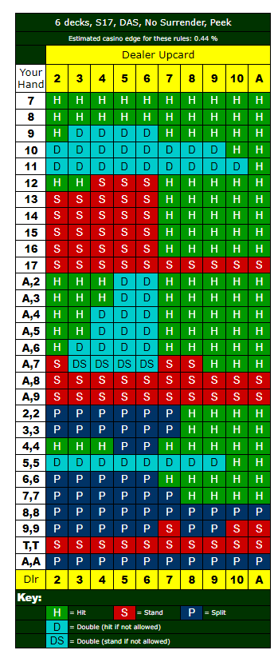
More examples:
Ed Thorp – Blackjack algorithm(1961)
Was later banned from some Las Vegas Casinos
Took to wearing disguises to gain entry
Caused casinos to increase the size of the card deck and ban portable computers
He went on to found a hedge fund that made 20% every year for 20 years in a row
One of the pioneers of algorithmic trading
(Maths can make you rich)

Slide 14
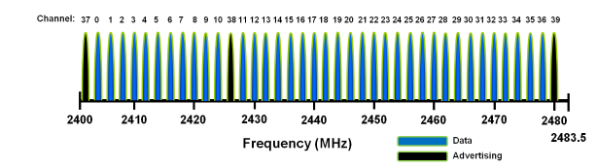
Bluetooth LE
on
off
Device pairs synchronise their listen/transmit periods, and save energy by using their radios only a fraction of the time (as low as 0.1%)
A transmits
time
B listens
An algorithm to save power
Device pairs synchronise hops to avoid interference with other devices in the area, incl Wi-Fi
On connect, a hop size N is agreed. They use 37 channels (a prime number). Why a prime number?
and
an algorithm to allow co-existence

Slide 15
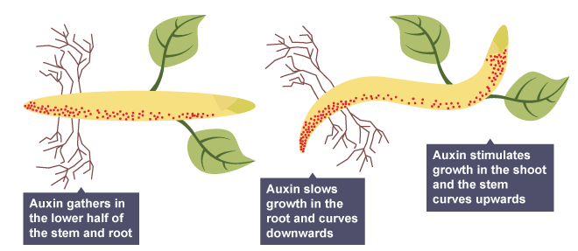

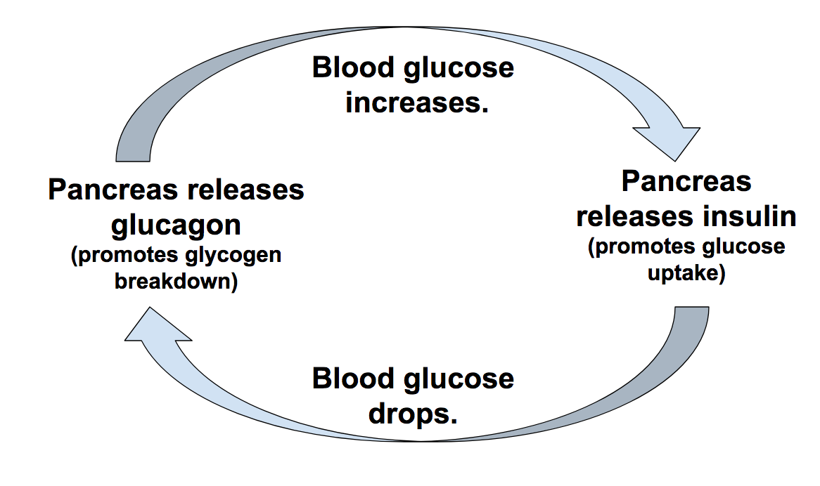


Algorithms are in nature
Nature provides inspiration for development of new algorithms
Notes:
Responsive algorithm
Control algorithm with feedback
Swarming algorithm – code is in the individual, rather than the whole system. In fact the galaxy is controlled by laws of physics
Flash crash 2010

Slide 16
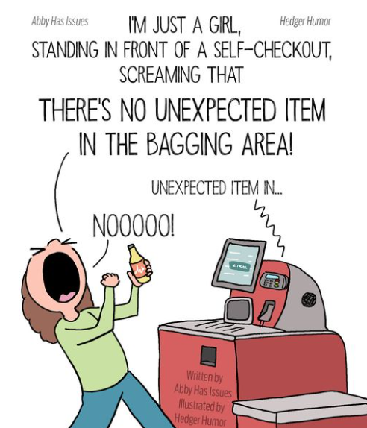
Algorithms are in everyday life
Think about the self-checkout machine at the supermarket
Let’s see if we can reverse-engineer its algorithm
What does the algorithm need to observe (events)?
barcode
weight
What programming features are used in the algorithm?
Are there do/while loops and if/then conditional statements?
Are there calculations?
Is external data fetched from a backend?
What causes the machine to say “Unexpected Item in the Bagging Area”?
Notes:
Whiteboard exercise – try Microsoft Whiteboard

Slide 17
IDLE
Wait for event
Happy path
Scan item
Put in bagging area
Scan item
Put in bagging area
Scan item
Put in bagging area
…etc
Finish and pay
Self-checkout machine exercise
Event type
Unhappy paths
Item removed before payment
Item added before scan
Notes:
Left
Scan
Fetch item weight and price
Update expected weight
“Place bag in bagging area”
<-
IDLE wait for item
Weight matches?
N: loop
Y: Update bill
Home
Right
Weigh
Weight matches?
N: Unexpected item in bagging area
IDLE Wait for item removal
loop
Y: Home

Slide 18
Universe of algorithms in programming
What you already know (but didn’t know you know)
All known algorithms
What I know
What they might ask you about at interview

Slide 19
First look at Sorting
The problem:
[3,4,1,5,2].sort() should equal [1,2,3,4,5]
As well as just sorting, many programming solutions depend on the result of a sort function:
find
check for missing item (or duplicates)
compare (sets)
We’ll briefly look today at animations of a simple algorithm and a more complex one:
Insertion sort
Merge sort
Notes:
Find
It’s easier to find a word if your data is sorted from A-Z
Missing
Find the missing one from a deck of cards
Compare
Do two sets of data contain the same items

Slide 20
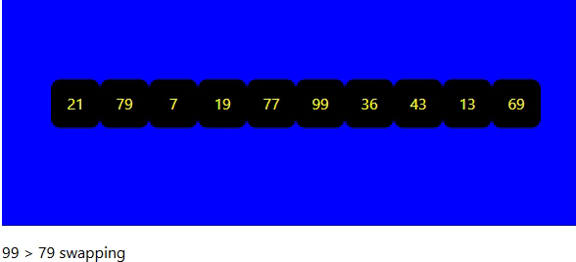
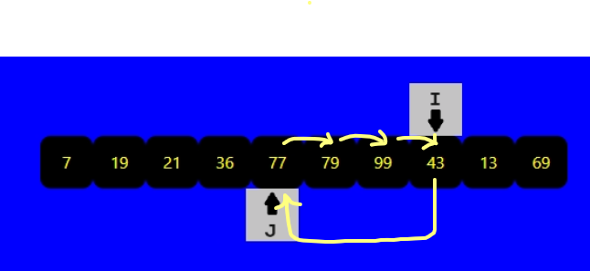
Insertion Sort
for (I = 1 to LENGTH-1) {
for (J = 0 to J-1) {
if (A[I] < A[J]) {
doRotate(J,I);
break;
}
}
}
Start by looking at the second element (using index variable I)
Look at every element to the left of I (using index variable J)
If they are out of order, move the element at I to J, and move everything from J one place to the left to fill the gap (this is called a rotate).
Repeat with next I.
Notes:
This is similar to how you could sort a hand of cards.
One of the simplest algorithms but not for general use. For educational purposes.
It’s OK if the data set is already nearly sorted. Like a new item was added to a sorted list.

Slide 21
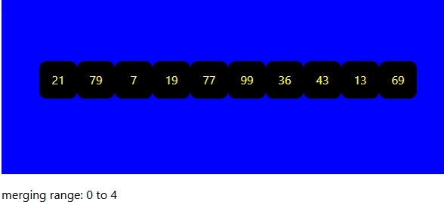
Merge Sort 2
21
79
19
7
77
99
36
43
13
69
1
21
79
7
19
77
99
36
43
13
69
2
4
7
19
21
79
36
43
77
99
13
69
Recipe:
divide array into pairs
sort each pair (using swap) -> sorted sub-array
while (number of sorted sub-arrays > 1)
for each pair of sub-arrays:
“sortmerge” the pair -> sorted sub-array
(sortmerge is happening in steps 2,3,4,5 on
the right)
3
7
19
21
36
43
77
79
99
13
69
5
7
13
19
21
36
43
69
77
79
99
Notes:
Don’t play animation first
Divide and Conquer
Recursive
Could be multithreaded

Slide 22
Pseudocode: recursive function call
function mergeSort (start, end) { // start, end of sub-array
if (start == end) return; // can’t go on forever
divider = somewhere_in_between_start_end(start, end)
// for (0,10) I chose 8 because it’s a power of 2, for (4,8) I chose 6
// but you can also just go halfway, it’ll still work
mergeSort (start, divider);
mergeSort (divider, end);
sortmerge(start->divider, divider->end);
// this is what is happening in the yellow boxes
}

Slide 23
Call structure: recursive function call
merge (0, 10)
14
16
1
15
merge (0, 8)
merge (8, 10)
7
13
2
8
merge (0, 4)
merge (4, 8)
4
5
12
3
6
11
10
9
merge (0, 2)
merge (2, 4)
merge (4, 6)
merge (6, 8)

Slide 24
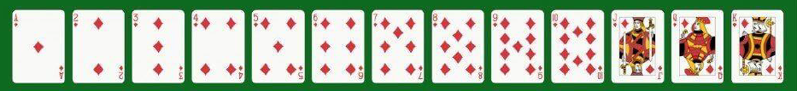
Experiment
Notes:
Shuffle
Deal out 5(10, 15, 20) cards face down
You will time how long it takes to sort them:
only allowed to use two hands
cards cannot be put down on the table
When clock starts:
pick up cards and sort them
Look at time when finished and remember it
Got to other screen with Excel and Stopwatch

Slide 25



Appreciating the art of sorting algorithms A look ahead to the next workshop
What does the input data look like?
nearly sorted already
finite vocabulary (true/false, days of week, currency code)
it’s actually changing all the time!
What output is required?
just the first few
just the comparison key
is it sorted again using another key (need stable sort)
Do they cope with enormous inputs?
Memory usage
Can they be multi-threaded?
Is the compare function expensive to call?
Is copy/Move and expensive operation?
Complexity O(n), O(n log(n))

Slide 26
Takeaways
You don’t need to know programming to learn algorithms
Many jobs in IT involve spending the vast majority of the time developing algorithms, not programs
Programming is just a tool, the solution to the business problem is in the algorithm
You can get your next programming job without knowing the programming language
The I in IT stands for Information, NOT Programming:
i.e.
Given some information, what do I do next ?
You won’t find the answer at https://javascript.info/ !

Slide 27

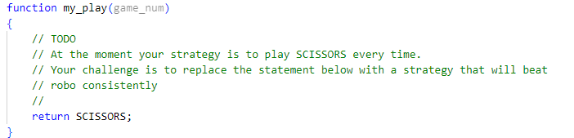
Homework Challenge Beat the Rock-Paper-Scissors Bot
The developers of an algorithm to play rock-paper-scissors think they have one that will win as many times as it will lose, so in the long run can’t be beaten consistently.
Your challenge is to implement an algorithm to beat it consistently.
SCISSORS beats PAPER
PAPER beats ROCK
ROCK beats SCISSORS
The code is at
https://github.com/wai-t/CompSci/blob/main/ComputerScience/Algorithms_Intro/rock_paper_scissors.js
You can run the program with “node rock_paper_scissors.js” in a terminal. Each run will play 1000 (NUM_GAMES) games. We get +1 for a win and -1 for a draw. If everything was equal we’d expect a final score of between -30 and +30.
In the function my_play(), you have to change the code so that it will consistently score above +30.
https://github.com/wai-t/CompSci/blob/main/ComputerScience/Algorithms_Intro/rock_paper_scissors.js

Slide 28
let robo_plays = []; // list of bot’s game history
function robo_play (game_num)
{ // robo’s secret sauce
if ( Math.random() < 0.25 && game_num > 0) {
robo_plays[game_num] = robo_plays[game_num-1];
}
else {
let rand = Math.floor( Math.random() * 3 ) ;
robo_plays[game_num] = plays[rand];
}
return robo_plays[game_num];
}
function my_play(game_num)
{
// TODO
// At the moment your strategy is to play SCISSORS every time.
// Your challenge is to replace the statement below with a strategy that will
// beat robo consistently
//
return SCISSORS;
}
Main function will loop round NUM_GAMES times, calling robo_play() and my_play() and decide who wins each game.

Slide 29
End of General Introduction

Slide 30
Declarative vs Imperative
Declarative | Imperative
What | How
I want a vanilla ice cream in a cone | Take a cone, put a scoop of vanilla ice cream on top
SQL, HTML, CSS | javascript, python, assembly
But in practice there’s a lot of overlap:
An SQL script can be thought of as an imperative script (because the order of execution matters)
Most languages you can program in a declarative style (collection algorithms, LINQ)
Indeed, all languages have declaration statements!
A system is usually a sandwich of alternating imperative and declarative layers with:
“run program command” at the top (imperative)
Machine code at the bottom (imperative)
Or Quantum physics at the bottom (declarative)

Slide 31
What does an “expensive” operation mean?
Usually means it takes a long time
The time it takes is a consequence of:
CPU clock cycles
Limited fast memory (on chip, on CPU)
Limited comm bandwidth (network, disk read/write speed)
Comparing every possible pair of a set of a zillion numbers is expensive, because:
That’s a lot of CPU instructions (zillion^2 executions of CMP, etc)
You probably don’t have a zillion bytes of fast memory (L1, L2, RAM), which means a lot of chip to disk data transfers
An operation can also be considered expensive if it:
Causes other operations to slow down
A resource hog (of cpu, bandwidth, blocked threads)

Slide 32
Recursion (of function calls)
Function that calls itself
Worker
boss = Manager
getCEO(Worker)
Class Employee {
boss: Employee;
}
function getCEO (employee) {
if (employee.boss)
return getCEO(employee.boss);
else
return employee;
}
6
1
Manager
boss = Director
getCEO(Manager)
5
2
getCEO(Director)
Director
boss = CEO
4
Warning: don’t do this unless you know it’s a short list.
CEO
boss = null
3
getCEO(CEO)

Slide 33
return
return
call
call
call
call

Slide 34






A personal career path
School
Science Video Games Space Shuttle Sim
BBC Micro ZX Spectrum BASIC, Z80 Assembler
Post grad
Particle Physics Simulation Data analysis
FORTRAN
Operational Control
Control Data acquistion
SQL
Airline Pricing
Price optimisation
C++ Roguewave
Quant Analytics
Rates modelling Simulation
C# C++ Python SQL
Transferrable Skill
Inexperienced
No experience
No experience

Slide 35
Self-checkout machine exercise
IDLE
Wait for event
Y
Update bill
Fetch item’s
Price and Weight
scan
Event type
weigh
Weight matches
N
Update expected weight
Y
Weight matches
N
Unexpected item in bagging area
IDLE
Wait for item removal
Place item in bagging area
IDLE
Wait for item

Slide 36
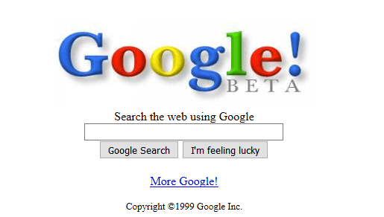

Slide 37
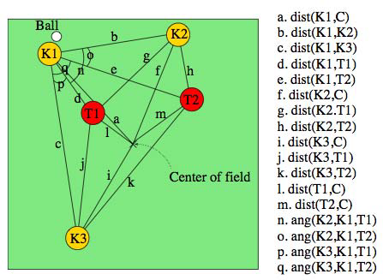
Robo-footballer training
Initialize ˆQt(s, a) arbitrarily.
Repeat (for each episode):
Initialize s.
Repeat (for each step):
Select an action a.
Execute the action a, observe r(s, a), s.
Update the values of Q(s, a) using 2.
s ← s.
Until s is terminal.
Until some stopping criterion is reached.
https://www.researchgate.net/publication/261046780_Reinforcement_Learning_with_Case-Based_Heuristics_for_RoboCup_Soccer_Keepaway

Slide 38
Insertion Sort
for (I = 1 to LENGTH-1) {
for (J = 0 to J-1) {
if (A[I] < A[J]) {
doRotate(J,I);
break;
}
}
}
Start by looking at the second element (using index variable I)
Look at every element to the left of I (using index variable J)
If they are out of order, move the element at I to J, and move everything from J one place to the left to fill the gap (this is called a rotate).
Repeat with next I.

Slide 39
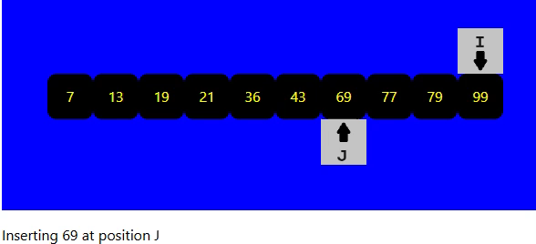
Selection Sort
for (I = 1 to LENGTH-1) {
for (j = I+1 to LENGTH-2) {
if (A[I] > A[J]) {
doSwap(I,J);
}
}
}
Note how as soon as I moves on to the next position, everything to the left of it is already known to be in the right order in the final result. This is very useful if you only want the first few elements from a huge array. E.g. it might be a Google search returns millions of records, but it only wants to show a page at a time.
Start by looking at the first element (using index variable I)
Look at every element to the right of I (using index variable J)
If they are out of order, swap I with J. (So at the end of every loop of J, the next element in the final result has been SELECTED)
Repeat with next I.

Slide 40
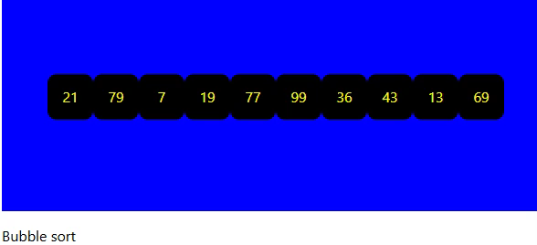
Bubble Sort
for (I = LENGTH-1 to 0) {
for (J=0 to I-1) {
if (A[I]>A[J+1]) {
doSwap(I,J+1);
}
}
}
Every time J increases, the largest element rises with it like a BUBBLE. Like the selection sort, after every iteration of I, the top few elements of the result are already available.
Start by looking at the LAST element (using index variable I)
Starting with J=0, compare every pair of elements A[J], A[J+1] which are to the left of I. If they are out of order, then swap J with J+1.
Decrement I.
Notice how few lines of code there are. If I’m stranded in a remote island in cyber-space where I don’t know the language well or the standard libraries, this is one I can write in my sleep. (But it’s not for production code usually)

Slide 41
Merge Sort
Divide the array into pairs of single elements
For each pair, swap them if they are out of order
For each pair of pairs, merge them into a sorted sub-array
For each pair of pairs of pairs, merge them into a sorted sub-array
For each pair of….., and so on
Until we get to the last
21
79
19
7
77
99
36
43
13
69
21
79
7
19
77
99
36
43
13
69
7
19
21
79
36
43
77
99
13
69
7
19
21
36
43
77
79
99
13
69
7
13
19
21
36
43
69
77
79
99

Slide 42
Merge Sort 2
MergeSort
Recursion A
Recursion B
Left subarray?
Yes
No
Right subarray?
Yes
21
79
19
7
77
99
36
43
13
69
Return from reursion
No
21
79
7
19
77
99
36
43
13
69
Return from reursion
7
19
21
79
36
43
77
99
13
69
Merge arrays
7
19
21
36
43
77
79
99
13
69
7
13
19
21
36
43
69
77
79
99

Slide 43
Quick Sort
A “pivot” is chosen and everything larger than it is moved to the right of it
21
79
19
7
77
99
36
43
13
69
21
19
7
36
43
13
69
79
77
99
P1
7
The algorithm is recursively applied to the two sub-arrays
13
21
19
36
43
79
77
99
P2
P8
7
21
19
36
43
77
79
P3
19
36
P4
P9
P10
21
The pivot is locked in place. It’s in the right position, and has split the array into one/two sub-arrays
19
21
P5
P6
P7

Slide 44
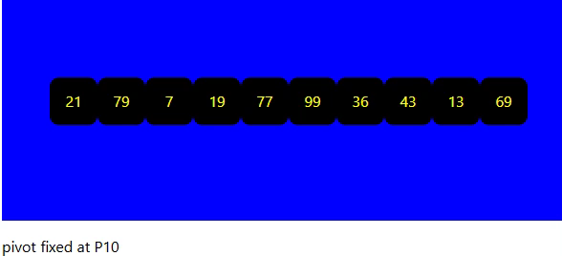
Quick Sort
QuickSort
pivot
Recursion A
Left subarray?
Yes
No
Recursion B
Right subarray?
The classical implement uses recursion. The Quick Sort method starts by picking the pivot element to split the array into two sub-arrays. Then for each sub-array it calls itself recursively. The recursion ends when there are no more non-zero length sub-arrays left.
Yes
No
Return A
Return B

Slide 45
So why can’t I just call sort()?
Probably can most of the time – default implementations are pretty efficient
Edge cases:
Only the first few elements needed
Input data is almost sorted
Input data is changing concurrently (HeapSort and Heaps – see another Workshop)
Finite set of possible values (true/false, days of week,

Slide 46
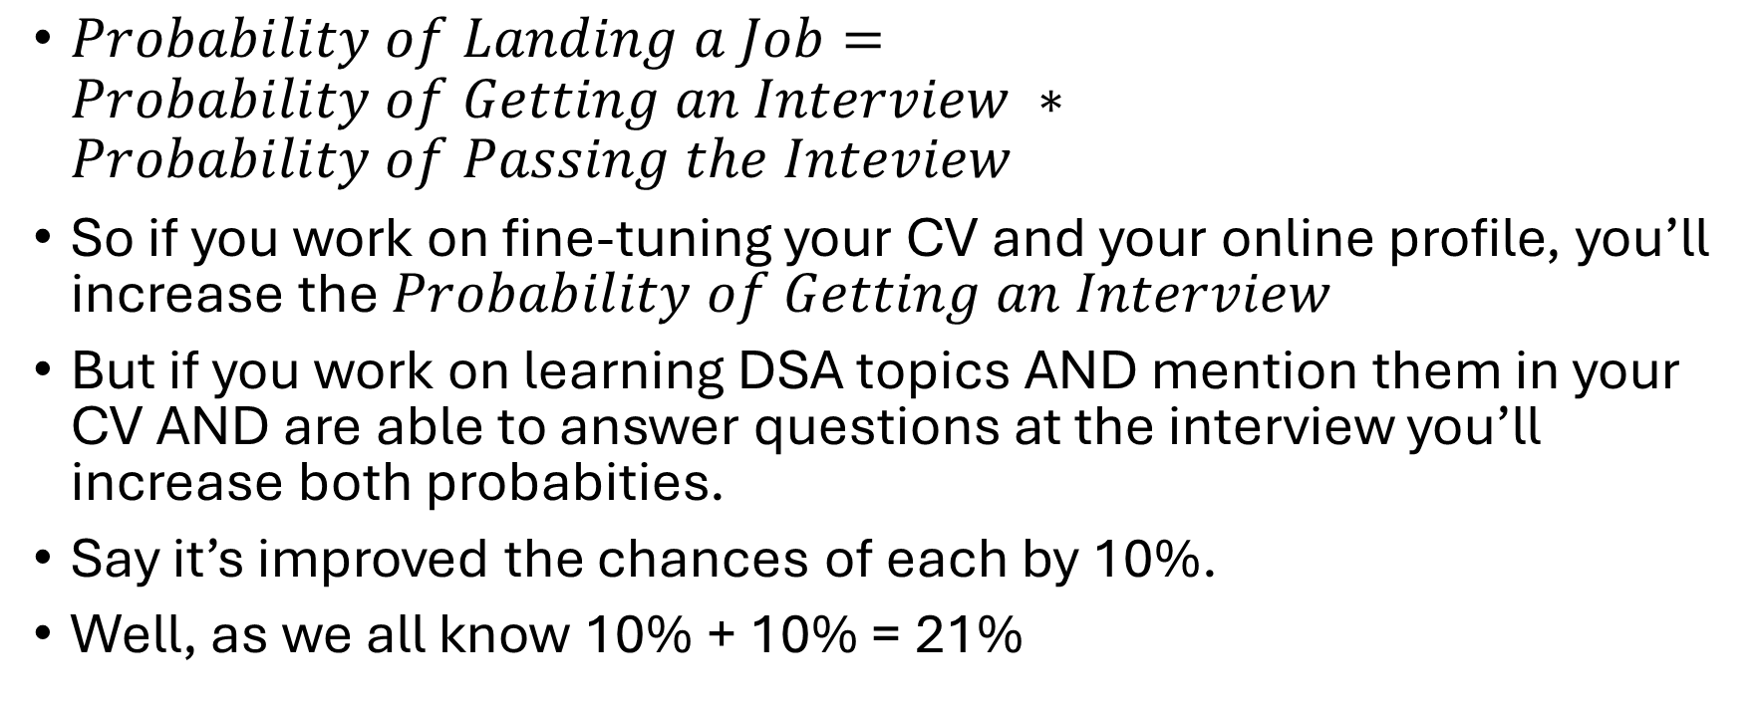
A Quant might look at it like this…
$Probability of Landing a Job=Probability of Getting an Interview ∗Probability of Passing the Inteview$
So if you work on fine-tuning your CV and your online profile, you’ll increase the $Probability of Getting an Interview$
But if you work on learning DSA topics AND mention them in your CV AND are able to answer questions at the interview you’ll increase both probabities.
Say it’s improved the chances of each by 10%.
Well, as we all know 10% + 10% = 21%

